Slide 1
Discrete decision making
Lecture 3. Decision-making paradoxes

Slide 2
Decision-making paradoxes
Monty Hall problem
Two envelopes problem
St. Petersburg paradox

Slide 3
1) Monty Hall problem

Slide 4
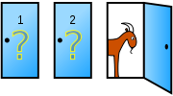
Description of the problem
“Suppose you're on a game show, and you're given the choice of three doors: Behind one door is a car; behind the others, goats. You pick a door, say No. 1, and the host, who knows what's behind the doors, opens another door, say No. 3, which has a goat. He then says to you, "Do you want to pick door No. 2?" Is it to your advantage to switch your choice?”
In search of a new car, the player picks a door, say 1. The game host then opens one of the other doors, say 3, to reveal a goat and offers to let the player pick door 2 instead of door 1.

Slide 5
Basic rules
The host must always open a door that was not picked by the contestant.
The host must always open a door to reveal a goat and never the car.
The host must always offer the chance to switch between the originally chosen door and the remaining closed door.

Slide 6
Simple solution
Player initially picks a door #1 in each case. The possible solutions are:
Behind door 1 | Behind door 2 | Behind door 3 | Result if staying at door #1 | Result if switching to the door offered
Car | Goat | Goat | Wins car | Wins goat
Goat | Car | Goat | Wins goat | Wins car
Goat | Goat | Car | Wins goat | Wins car

Slide 7
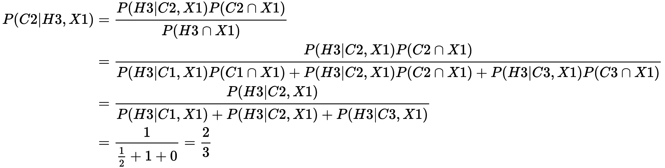
Theoretical solution
Consider the events C1, C2 and C3 indicating that the car is behind respectively door 1, 2 or 3. These three events all have probability 1/3. The player initially choosing door 1 is described by the event X1.
If the player initially selects door 1, and the host opens door 3, the conditional probability of winning by switching is

Slide 8
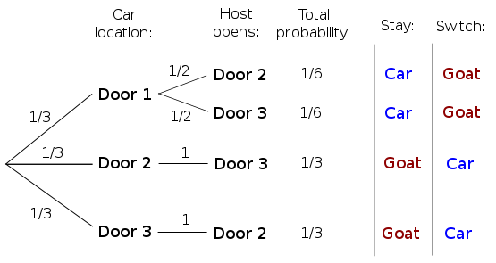
Direct calculation of probability

Slide 9
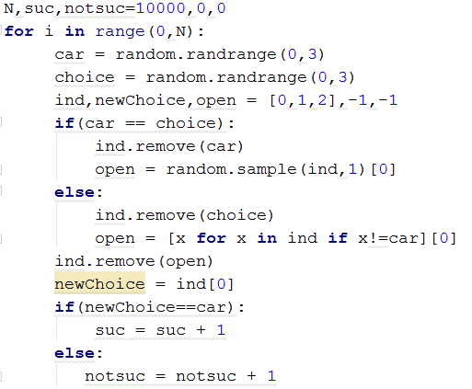
Solution by simulation

Slide 10
Other strategies (1)
Strategy 1:
"Monty from Hell": The host offers the option to switch only when the player's initial choice is the winning door.
Result: Switching always yields a goat.
Strategy 2:
"Angelic Monty": The host offers the option to switch only when the player has chosen incorrectly
Result: Switching always wins the car.

Slide 11
Other strategies (2)
Strategy 3:
The host does not know what lies behind the doors, and opens one at random that happens not to reveal the car (MH_problem2_en.py).
Result: Switching wins the car half of the time.
Strategy 4:
The host knows what lies behind the doors, and (before the player's choice) chooses at random which goat to reveal. He offers the option to switch only when the player's choice is the same as host’s choice.
(MH_problem3_en.py).
Result: Switching always wins the car.

Slide 12
Other strategies (3)
Strategy 5:
The host opens a door and makes the offer to switch 100% of the time if the player picked the goat, and 50% the time otherwise. (MH_problem4_en.py).
Result: Switching wins the car half of the time.
Strategy 6:
The host asks the player to open a door, then offers a switch in case the car hasn't been revealed (MH_problem5_en.py).
Result: Switching wins the car with probability 2/3.

Slide 13
2) Two envelopes problem

Slide 14

Description
“You are given two indistinguishable envelopes, each of which contains a positive sum of money. One envelope contains twice as much as the other. You may pick one envelope and keep whatever amount it contains. You pick one envelope at random but before you open it you are given the chance to take the other envelope instead.”

Slide 15
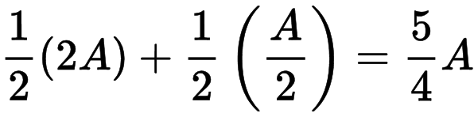
The switching argument
Other envelope contains 2A with probability 1/2 and A/2 with probability 1/2.
The expected value of the money in the other envelope is:

Slide 16
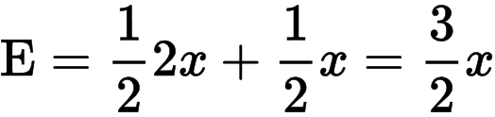
Resolution
The total amount in both envelopes is a constant c=3x (x in first,2x in second).
The expected value:
It is the same for both the envelopes.

Slide 17
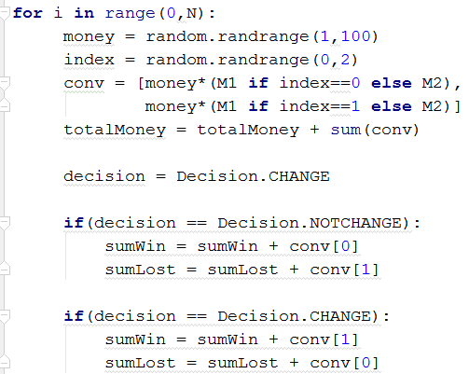
Solution by simulation

Slide 18
Other strategies (Thomas M. Cover optimization)
Strategy 1:
Change decision if the amount of money in the first envelope is less than in previous game.
Strategy 2:
Change decision if the amount of money in the first envelope is less than average in all previous games.

Slide 19
3) St. Petersburg paradox (The paradox takes its name from its resolution by Daniel Bernoulli, one-time resident of the eponymous Russian city, who published his arguments in the Commentaries of the Imperial Academy of Science of Saint Petersburg (Bernoulli 1738))

Slide 20
Description
A casino offers a game of chance for a single player in which a fair coin is tossed at each stage. The initial stake starts at 2 dollars and is doubled every time heads appears. The first time tails appears, the game ends and the player wins whatever is in the pot. Thus the player wins 2 dollars if tails appears on the first toss, 4 dollars if heads appears on the first toss and tails on the second, 8 dollars if heads appears on the first two tosses and tails on the third, and so on. Mathematically, the player wins 2^k dollars, where k equals number of tosses (k must be a whole number and greater than zero). What would be a fair price to pay the casino for entering the game?

Slide 21
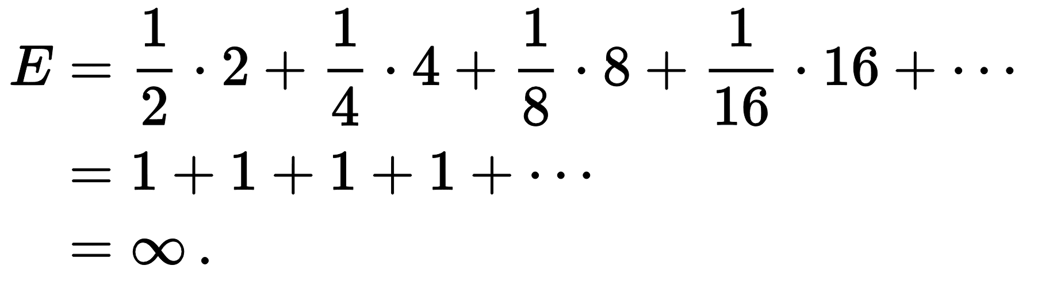
Theoretical expected value

Slide 22
Theoretical expected value
Assuming the game can continue as long as the coin toss results in heads and in particular that the casino has unlimited resources, this sum grows without bound and so the expected win for repeated play is an infinite amount of money.

Slide 23
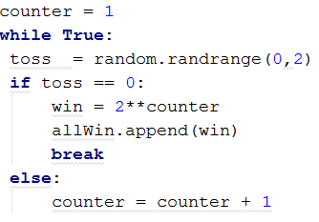
Solution by simulation
One game algorithm:
counter = 1
While “coin toss result” is head:
result = new coin toss
counter = counter + 1
win = 2^ counter
Implementation:

Slide 24
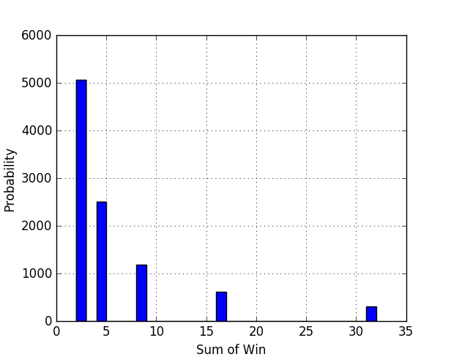
Results

